Slide 1


Cohort 1 Bootcamp :
Data Science Track (Project)
GROUP ONE:
Data Tech Titans (DTT)
SDG: NO POVERTY

Slide 2
Prediction On Financial Inclusion In Africa.

Slide 3
Problem Identification
Financial Inclusion remains one of the main obstacles to economic and human development in Africa
For example, across Kenya, Rwanda, Tanzania, and Uganda only 9.1 million adults (or 13.9% of the adult population) have access to or use a commercial bank account
The objective of this project is to create a machine learning model to predict which individuals are most likely to have or use a bank account.
This is a classification problem because our Target variable is Categorical.

Slide 4
Data Wrangling
Data was collected from Zindi Africa Financial inclusion in Africa Competition.
Variable definitions of the data
country: Country interviewee is in.
year: Year survey was done in.
location_type: Type of location: Rural, Urban
cellphone_access: If interviewee has access to a cellphone: Yes, No
household_size: Number of people living in one house
age_of_respondent: The age of the interviewee
gender_of_respondent: Gender of interviewee: Male, Female
From the data cleaning carried out, no missing values were found.

Slide 5
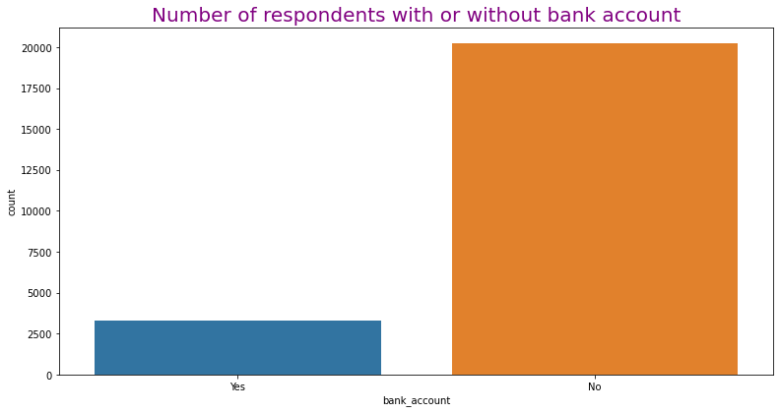
Exploratory Data Analysis
Univariate analysis.
Using count plot visualization, 85.92% of the respondents do not have a bank account.

Slide 6
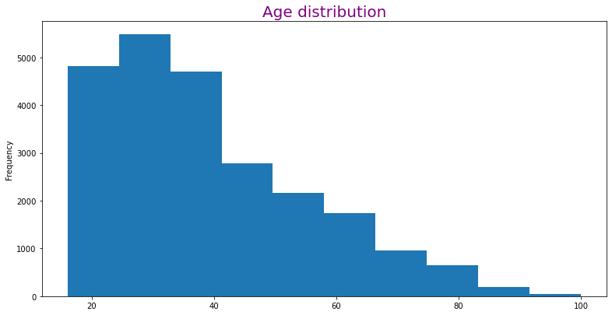
Most of the respondents are between 20-40 years old.

Slide 7
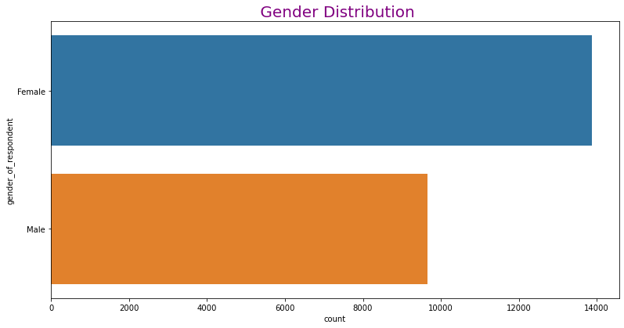
Most of the respondents are female.

Slide 8
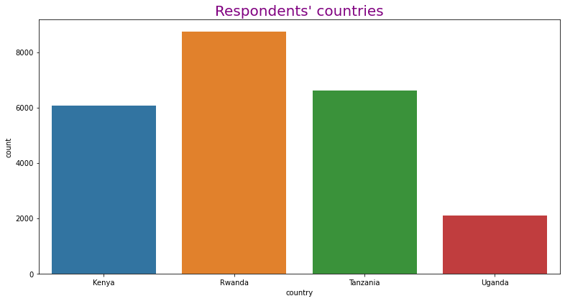
From the count plot below, majority of the respondents are from Rwanda.

Slide 9
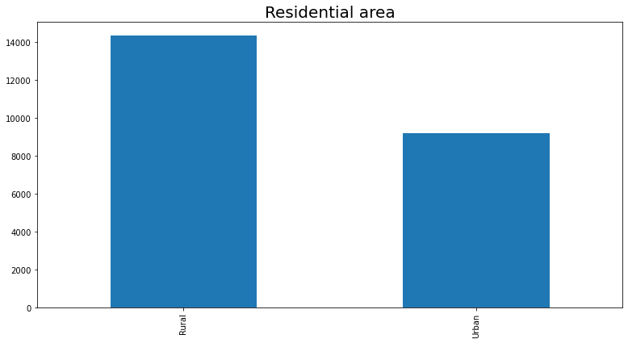
Majority of the respondents reside in the rural sector.

Slide 10
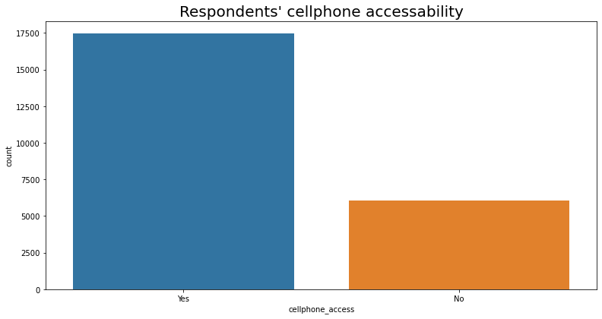
Most of the respondents have access to cellphones.

Slide 11
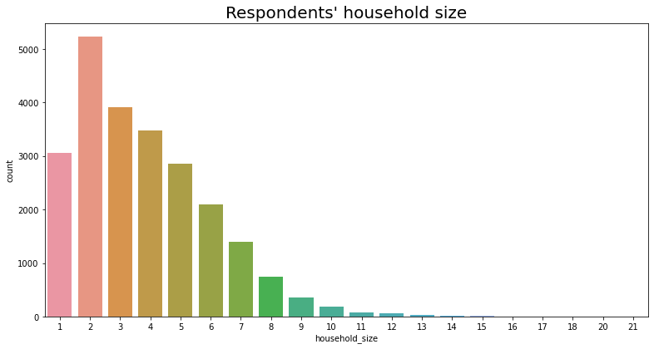
The household size of most respondents is two.

Slide 12
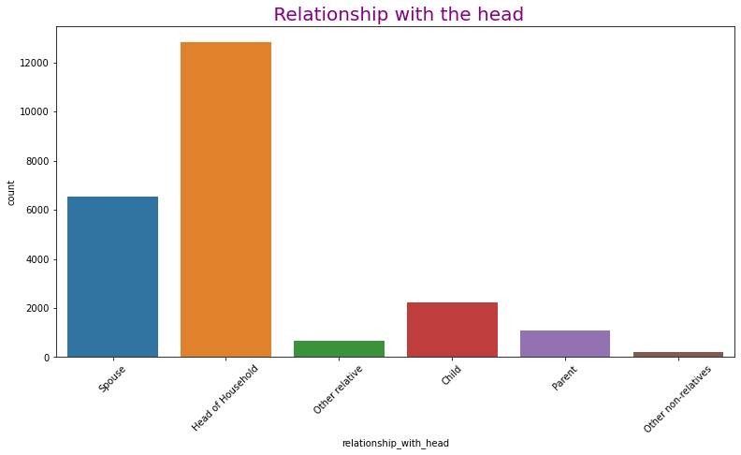
Most of the respondents are head of their households.

Slide 13
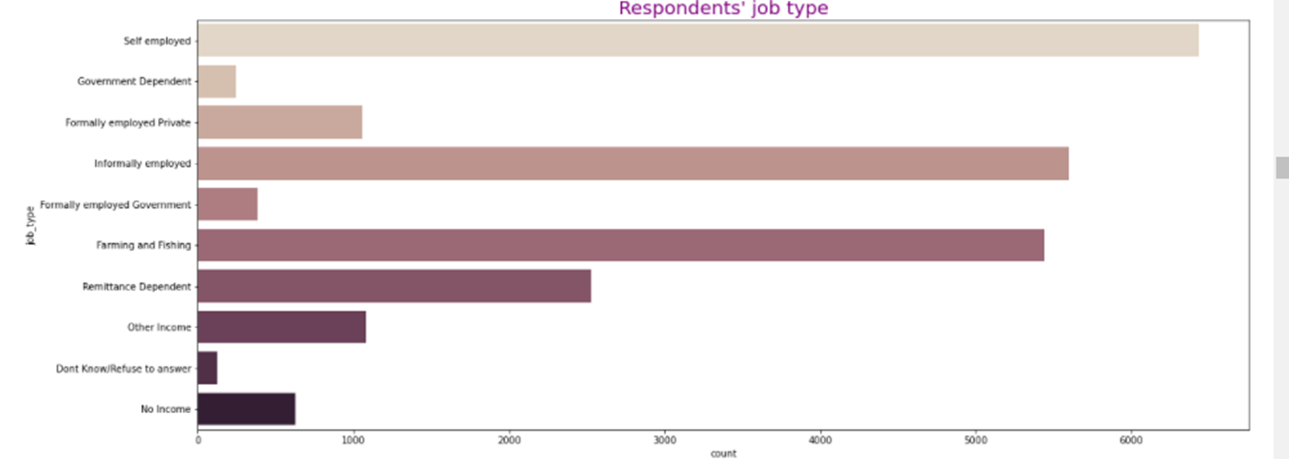
Most of the respondents are self employed.

Slide 14
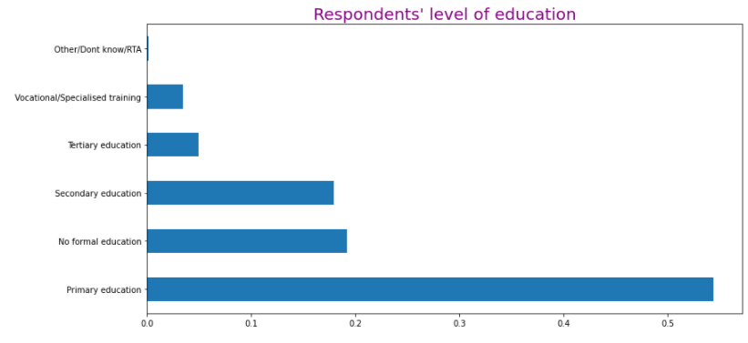
Few of the respondents have reached tertiary level of education.

Slide 15
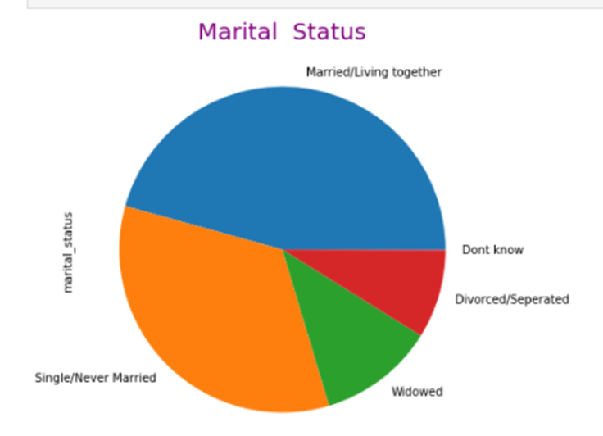
Pie chart visualization of respondents marital status.
45.7%
8.8%
33.9%
11.5%

Slide 16
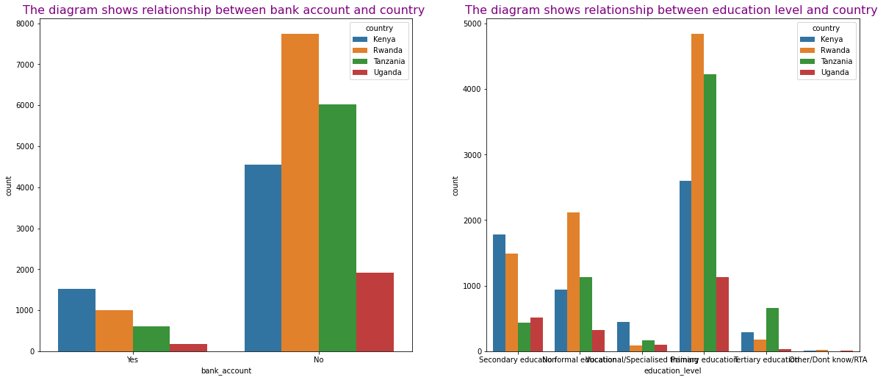
Bivariate analysis.
The analysis shows relationships between owning a bank account and other variables.

Slide 17
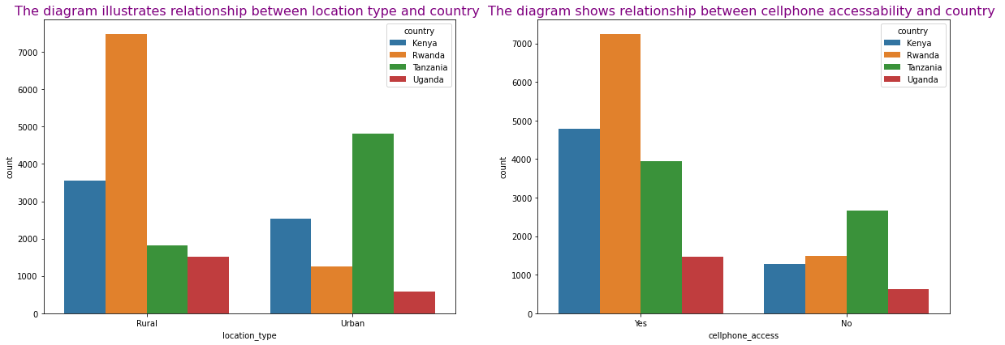
Respondents’ location type and cellphone access.

Slide 18
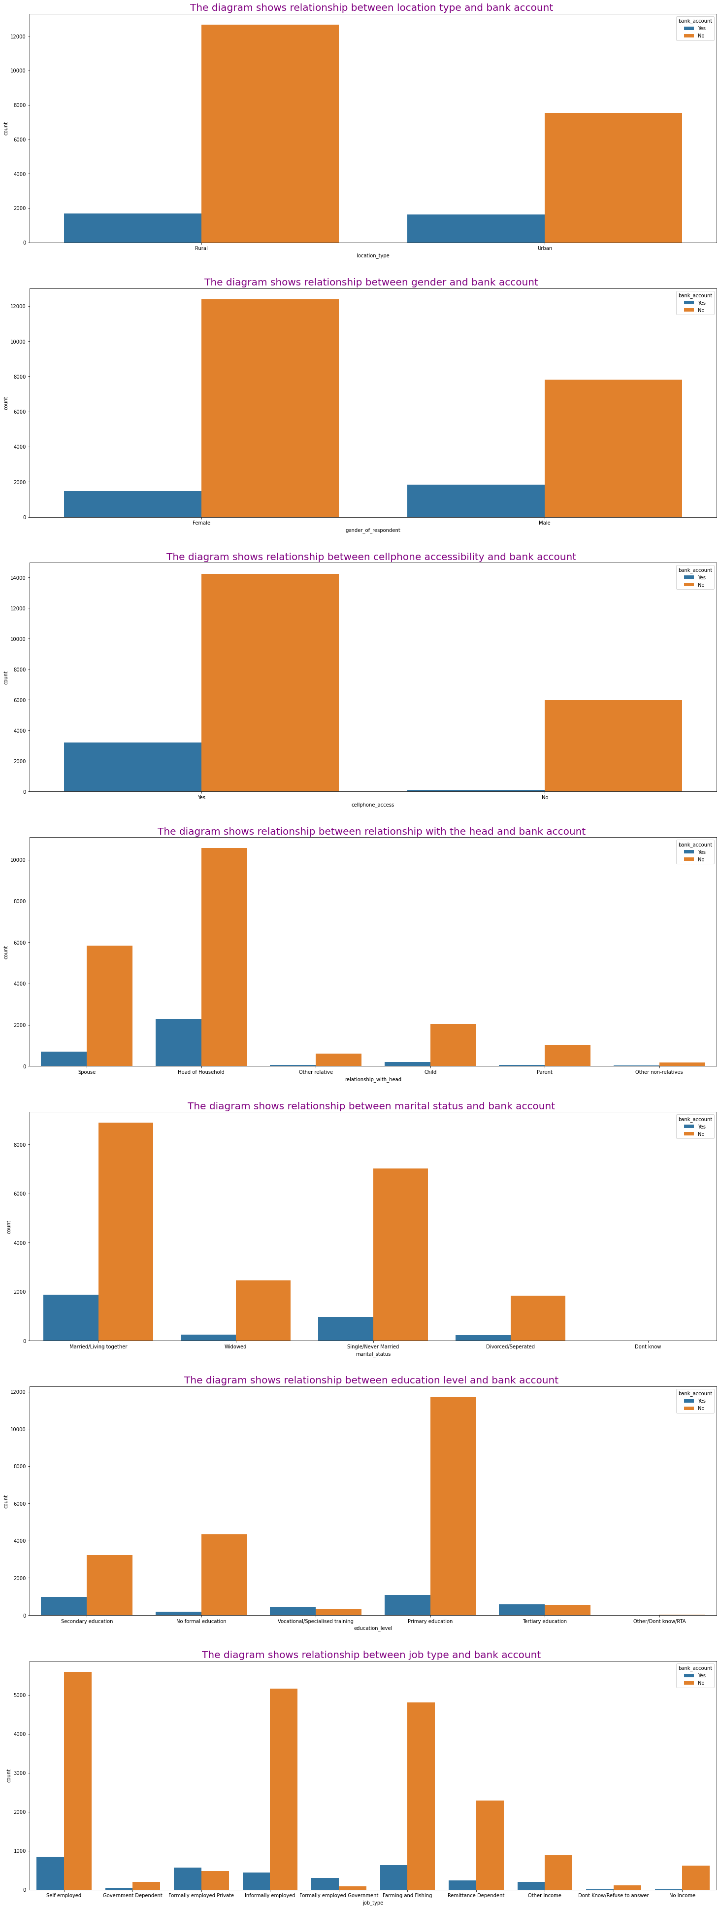
The number of respondents without a bank account is higher in the rural areas.

Slide 19
The number of female respondents without a bank account is higher.

Slide 20
The number of respondents without a bank account is higher for those with cellphone access.

Slide 21
The heads of the households represent most of the respondents that have a bank account.

Slide 22
Respondents with bank accounts are mostly married.

Slide 23
Those who didn’t go beyond the primary level of education, lead in the count of those without a bank account.

Slide 24
The self employed lead in the number of respondents without a bank account.

Slide 25
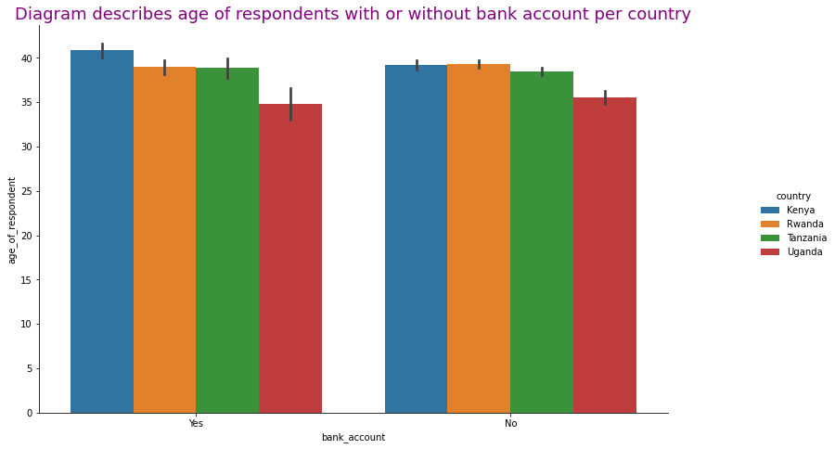
The cat plot below shows the number of bank account holders by the age of respondents and country.

Slide 26
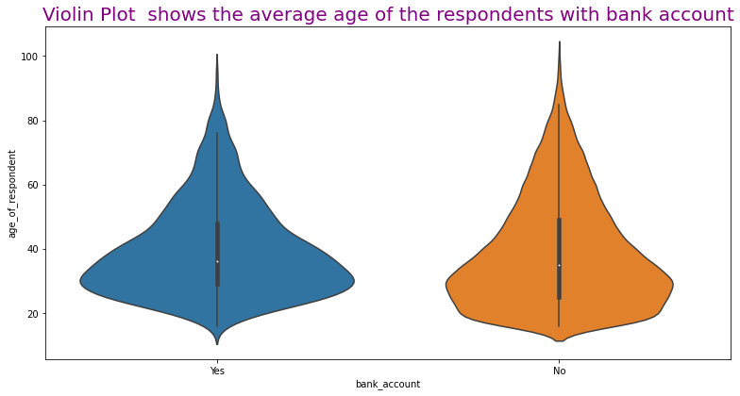
From the violin plot below, majority of bank account owners are between the age of 30 and 40.

Slide 27
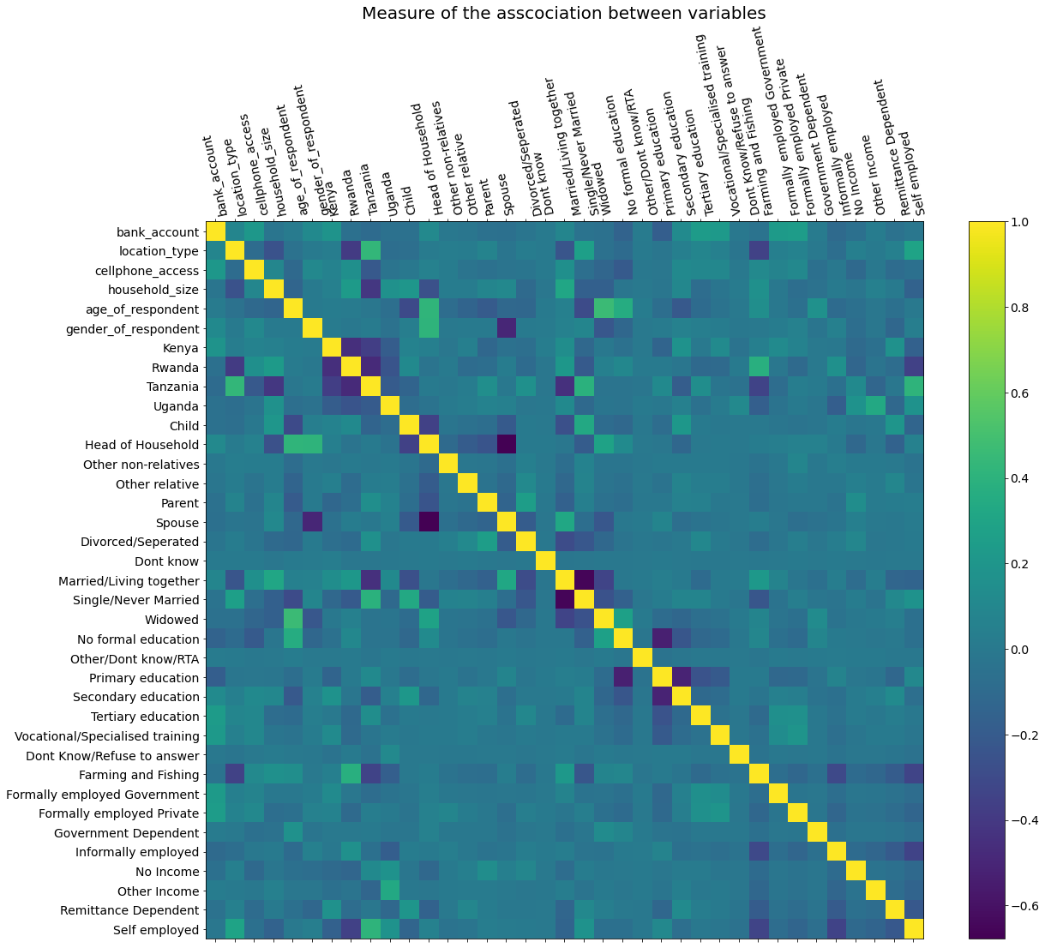

Slide 28
Preprocessing and Training Data Development.
Dummy features were created from the country, relationship with head, marital status, education level and job type columns for both test and train datasets.
The columns used in creating the dummy features were dropped, because they appear to be categorical rather than numerical alongside some other attributes.
The target and gender variables were normalized and remaining features were standardized using the label encoder i.e. converted to numeric, while age and household were standardized using minmax scaler.
The dataset was then split into training and testing sets.
The split datasets were then fit on a model.

Slide 29
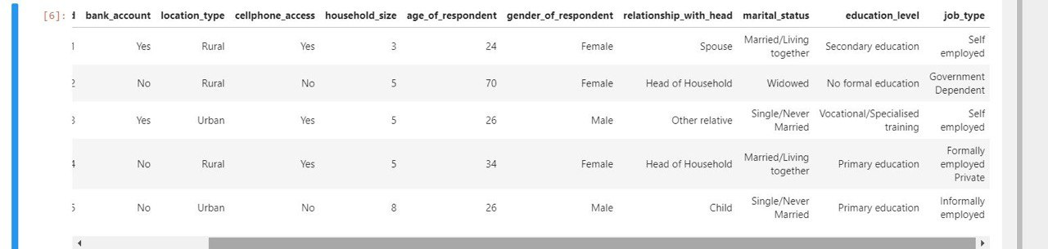
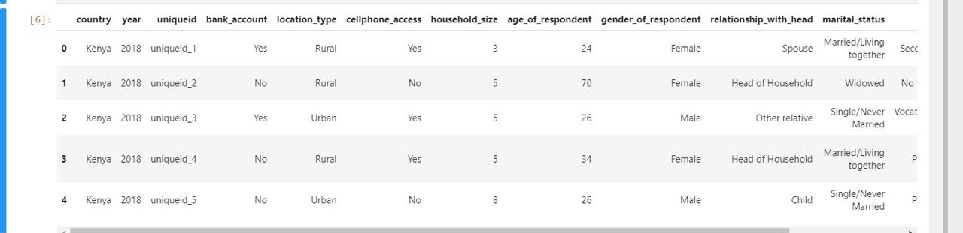
Before Standardization;

Slide 30
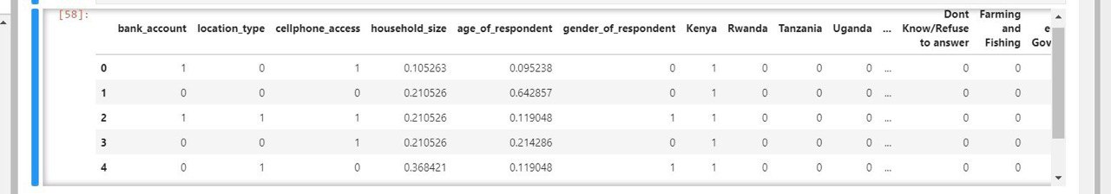
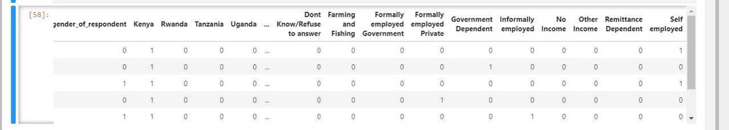
After Standardization;

Slide 31
Modeling.
The models Logistic regression, Gaussian naive bayes, Support vector classifier, decision tree classifier, Random forest classifier and K neighbors classifier were imported and used to fit the train data.
Predictions were made on each model and performance was evaluated using the Accuracy, Precision and Recall metrics.
The Final model with the best performance happened to be Support vector classifier with an accuracy of 89.04% and F1 score of 0.44
It ranks 0.14 on the Zindi Africa leaderboard.

Slide 32
Modeling.
Performance metrics.
MODEL | Accuracy(%) | F1-score | Zindi Score
Logistic Regression | 88.65 | 0.43 | 0.1842
Decision Tree | 83.89 | 0.40 | 0.2251
Random Forest | 86.87 | 0.44 | 0.2036
K Nearest Neighbors | 87.91 | 0.42 | 0.1934
Support Vector Machine | 89.04 | 0.44 | 0.1409

Slide 33
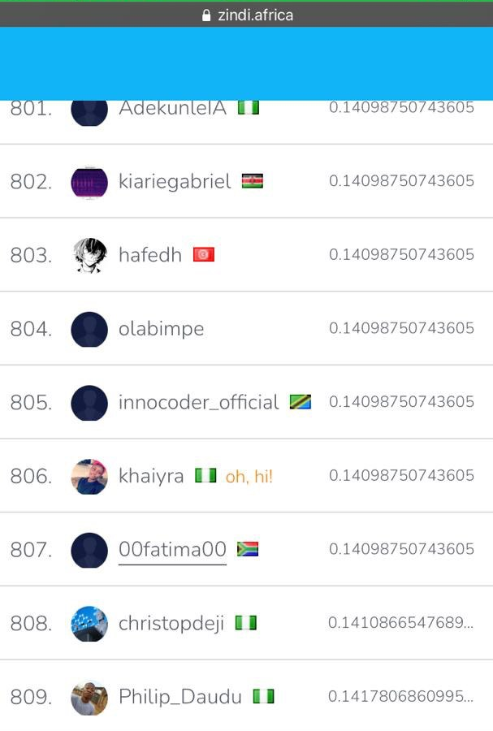
Our submission was no. 806 on Zindi.

Slide 34
Conclusion.
Our prediction had a variance of 0.14 against the actual data.
From the analysis, several factors play a key role in determining individual ownership of bank accounts.
Although access to cellphones should be a strong factor that influences users to own a bank account; as it would mean easier access to bank services, the analysis proved otherwise since most of the respondents had cellphone access but no bank account. This makes cellphone access a minor factor in determining bank account ownership.
In the analysis, those with more responsibilities such as the heads of the households and the married respondents, were seen to have bank accounts. We can conclude that increased responsibility, encourages people to hold bank accounts.

Slide 35
Thank you!

